Slide 1
Jewish Family Service
A Community Resource Since 1918
Volunteer Orientation
Notes:
Notes:
Prior to scheduling orientation, provide facilities a layout of room
Plan to host orientation at least x3 month (i.e., morning, afternoon & evening timeframe)
Set-up room 30-minutes before orientation
Make sure to set-up VE laptop for volunteers to complete their application
Provide potential volunteer w/ a JFS pen, volunteer flyer & VE business card (no lanyards until they sign-up/start!)
Set-up AV w/ PP & audio

Slide 2
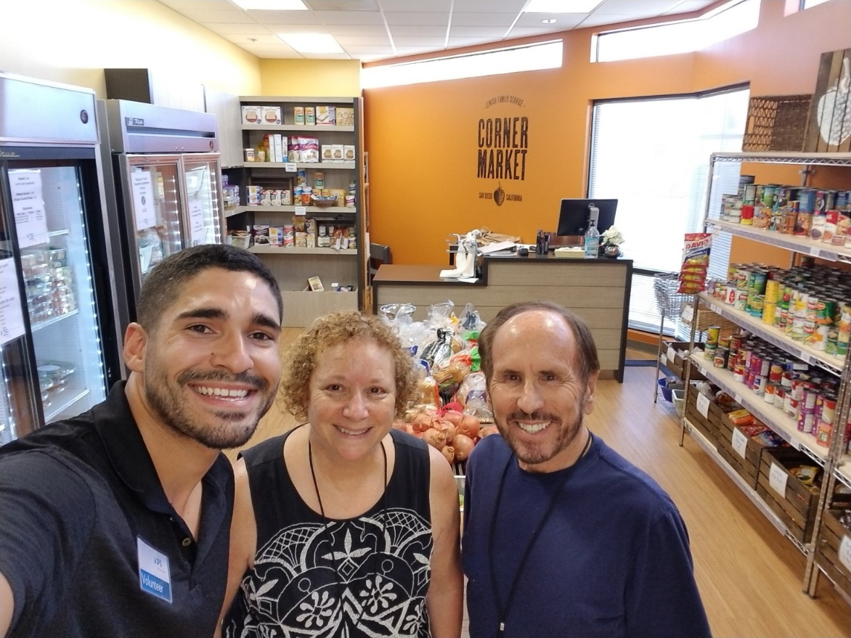
Welcome & Introductions
Icebreaker: What inspired you to volunteer with JFS?
Notes:
Notes:
Facilitator introduce themselves & provide relation to JFS
facilitator should start the introductions and share WHY he/she is with the organization/feel a connection to the mission
Depending on the recruitment & marketing content theme, we will ask our potential volunteers “have you ever…” and share what he/she is interested in at JFS
Provide Volunteer Engagement & JFS updates

Slide 3
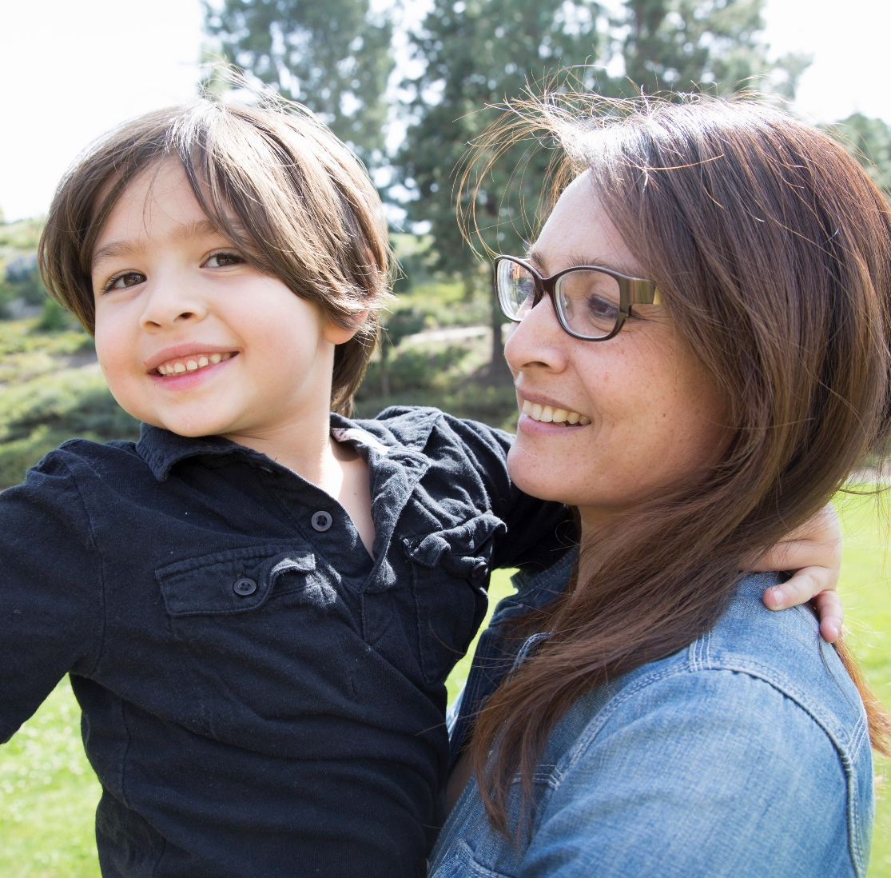
Our History & Purpose
Jewish Family Service
is a client-centered, impact-driven
organization working to build
a stronger, healthier,
more resilient San Diego.
Notes:
Notes:
This our mission statement, you can see it in everything we do and every program design. We started off in 1918 with a group of sixteen women who united four Jewish women’s groups and established what is now JFS. In the beginning they focused on welcoming European refugees who were fleeing their countries. These groups came through south America and were at the border. The Women set up temporary shelter, food assistance, and a process for getting the proper documentation. We continue that work today even stronger through our Refugee Resettlement and Immigration Programs. Now through our 40+ programs we help 20,000 San Diegans each year. As a wrap around agency that provides whole person service we focus on uplifting individuals and families and supporting aging with dignity, we help people of all ages, faiths, and backgrounds build more stable, secure, and connected lives.

Slide 4
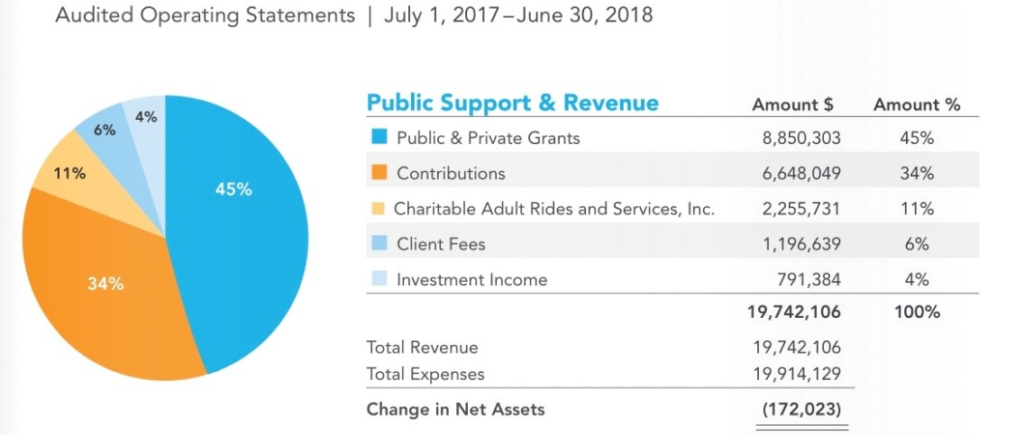
How We Are Funded
Notes:
Notes:
This report shows where we receive our funding as you can see 34% of our funding comes from Contributions, which as you know means people just like you are donating their time and funds to help JFS provide our services to 20,000 clients annually. If you are interested in Donating we do have an option on Galaxy Digital to donate if you desire to do that.

Slide 5

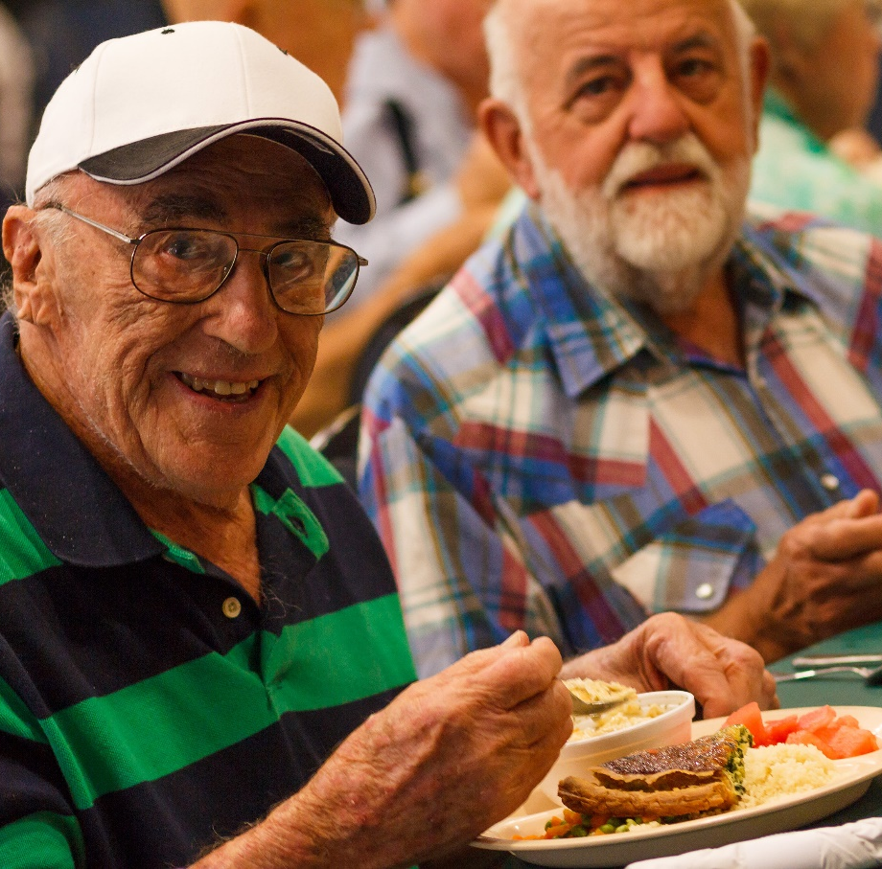
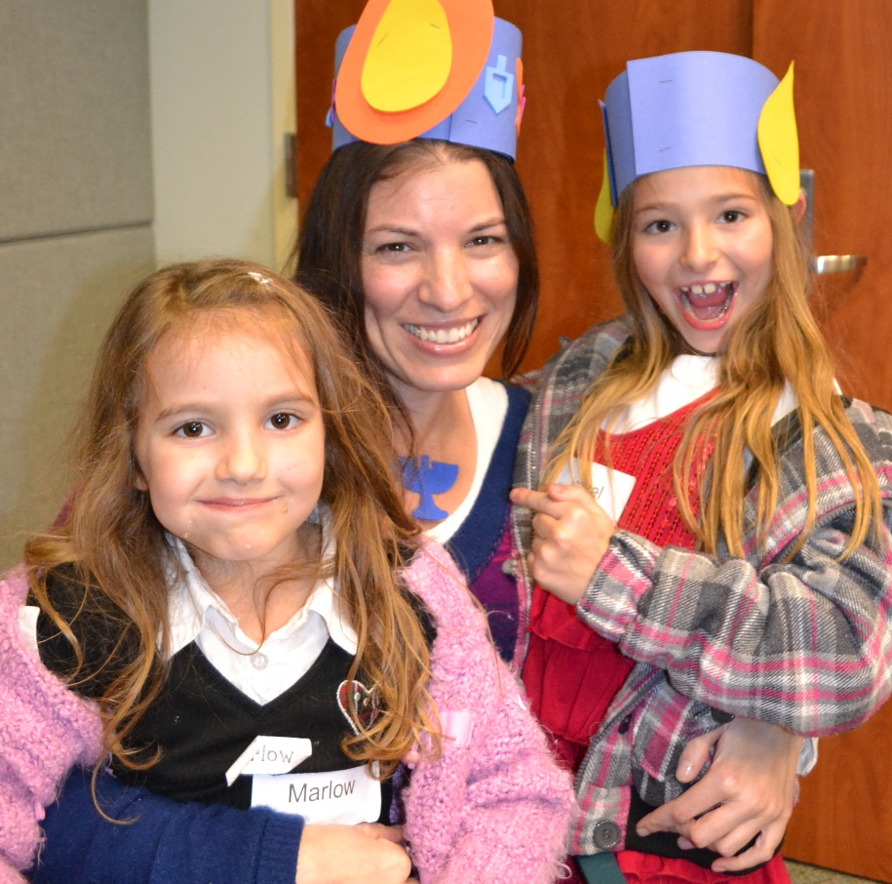
What We Do… Since 1918
Self-Sufficiency
Aging With Dignity
Community Connections
Notes:
Notes:
In 2014 our CEO and agency established out strategic plan which will carry us through this year. They established 3 impact areas.
The first being self-sufficiency. All of our programs are designed to meet clients where they are and move them to where they want to be. We want to help families to have the confidence and the ability to provide for themselves and their loved ones. One example of this is our diaper bank. We noticed that families were short about 20 diapers per month. So we established our diaper genie program and volunteer opportunity. Individuals in the community can call our diaper genie program and provide the sizes of their children and we provide 40 diapers per child. (They can call in once a month)
The second area is Aging with dignity. We learned in one of our donuts and discussions that was focused on aging and wellness that our aging population will increase by 30% by 2030. This is where JFS can come in with our services offering social visits, rides, food, and social wellness centers.
And our third area is community connections. Which happen through our partnerships with other non-profits, corporations, community members, and you our volunteer staff.

Slide 6
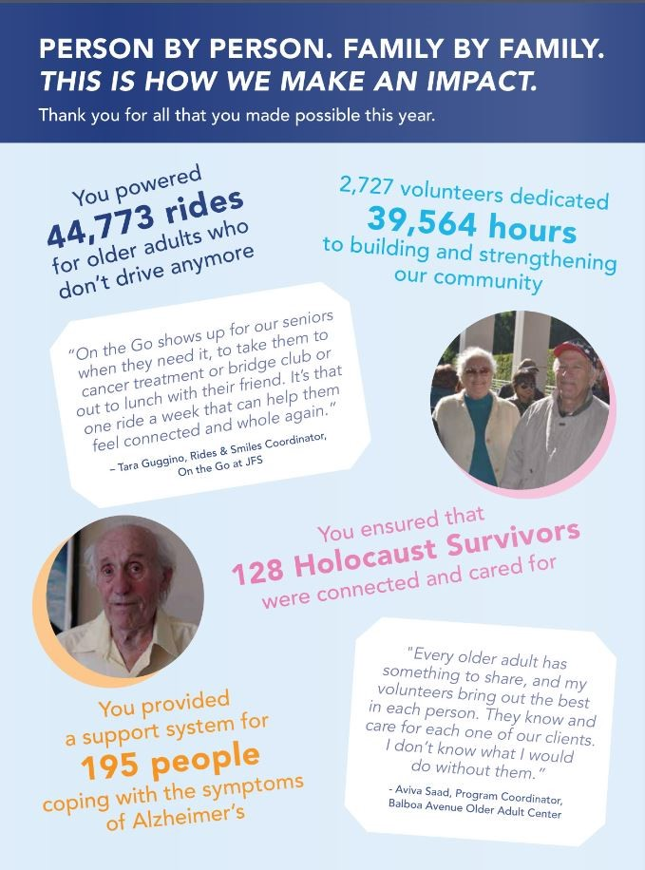

Impact Areas
Every day, people turn to JFS because they need someone in their corner. We welcome everyone with dignity, compassion, and respect.
We listen to clients’ whole stories—not just the needs that brought them here—and approach their challenges with their strengths, motivations, and unique circumstances in mind.
Notes:
Notes:
Highlight:
SPP
Rides and Smiles/Foodmobile: NATE
PPP: The Positive Parenting Program (PPP) helps parents in San Diego County find positive solutions to common childhood behavior issues using strategies proven by more than 35 years of research. The curriculum is based on Triple P, an evidenced-based program that has been shown to promote family harmony, reduce parent-child conflict, foster successful peer relationships, and prepare children for successful experiences at school.
BAOAC
Corner Market

Slide 7
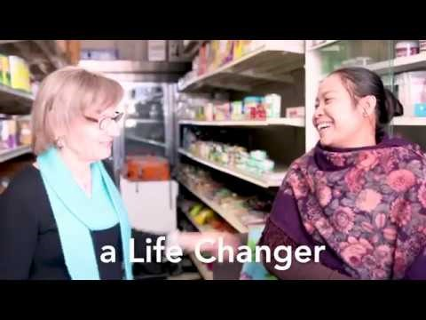
What It Means to Volunteer
Notes:
Notes:
Facilitator: https://www.youtube.com/watch?v=645I7Yzxfb8&t=13s
Let audience know we are updating video
This video was actually made by a high school intern, he’s heading off to college to become a E.R. doctor, so Cheyenne partnered him up with our Older Adult center here on campus where they live with dementia and Alzheimer's disease, because it is important for him to advocate for the patients that he might come across in his field. He also was very interested in videography so we partnered him up with the marketing department and he was able to actually create this video which has been shown over 2 million times. He gets a real kick out of knowing that.

Slide 8
900+ volunteers annually
Notes:
Notes:
We actually have about 1,000 volunteers now.
And we offer 180 ways to get involved which we are gonna talk about now!

Slide 9
How YOU Can Get Involved!
Assist in the office
Be an advocate
Be a mentor
Help the hungry
One-time projects & events
Serve older adults
Support refugee & immigrant families
Serving people facing homelessness
Notes:
Notes:
If you pull out of your packet that orange flyer you can see some of the ways that you can start volunteering.
When we go on a tour, we will get to see some of these volunteer opportunities in action
Next slide will reference the high needs which is also on a sheet in your packet

Slide 10
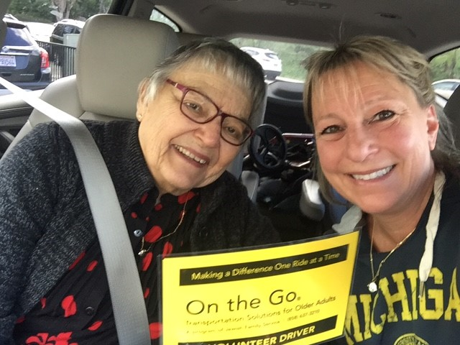
High Need Volunteer Roles
On the Go
Rides & Smiles
Corner Market
Music & Memory
Notes:
Note:
A high needs program has been identified by our board as a program that cannot exist without our volunteer staff.
So some of these are listed above.

Slide 11

Galaxy Digital
Check out opportunities
Sign up for shifts
See your schedule
RSVP to events
Log your hours
See your impact
Notes:
Notes:
SHOW:
How to sign up for shifts
How to add skills to your profile
How to see your schedule
Galaxy Digital is our online Volunteer Database, most of you should be familiar with it because its how you signed up for orientation today!
We are going to do a quick little walk through right now so that you can see how to express interest and log your hours!

Slide 12
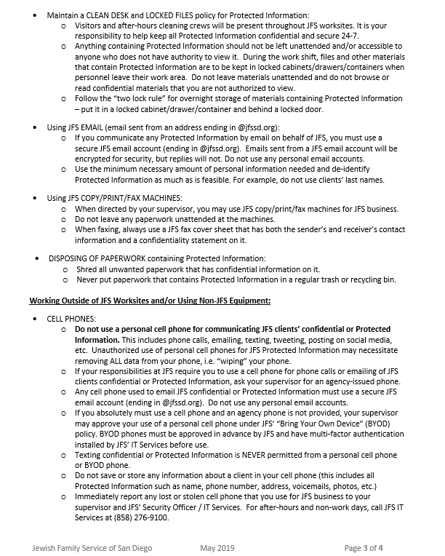
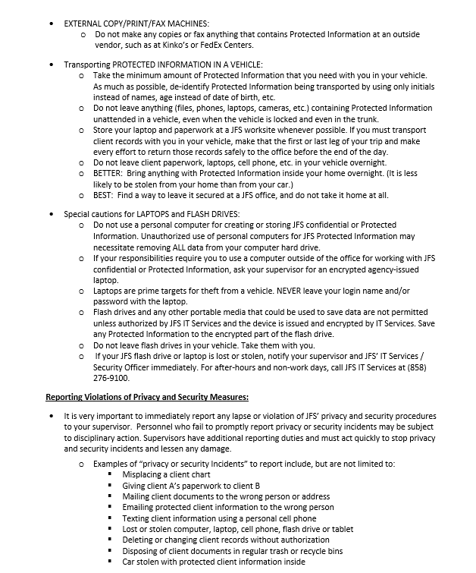
HIPAA Level One
Notes:
Notes:
Dress code: We encourage you to wear what you are comfortable in, but we are business casual, and if you are volunteering with hand up food pantry or the BAOAC we ask you to wear close toed shoes because you are working around heavy machinery or dancing and we’d hate for you to get your foot stepped on, because that hurts!
If you’ve worked in the medical field or other areas you might be familiar with HIPAA. It essential is the agreement that you will not share client information and in return we do not share your information. Take a minute to read over the policy on the front page of the handout in your packet and pass back to me when your done.
Congratulations you are all now HIPAA level one certified!
Now for parking! You should have in your packets a volunteer parking pass (CHANGE SLIDE)

Slide 13
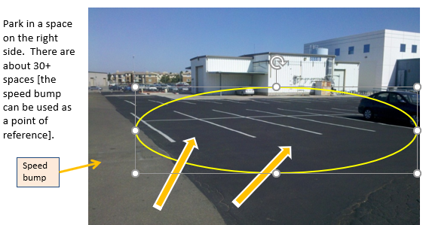
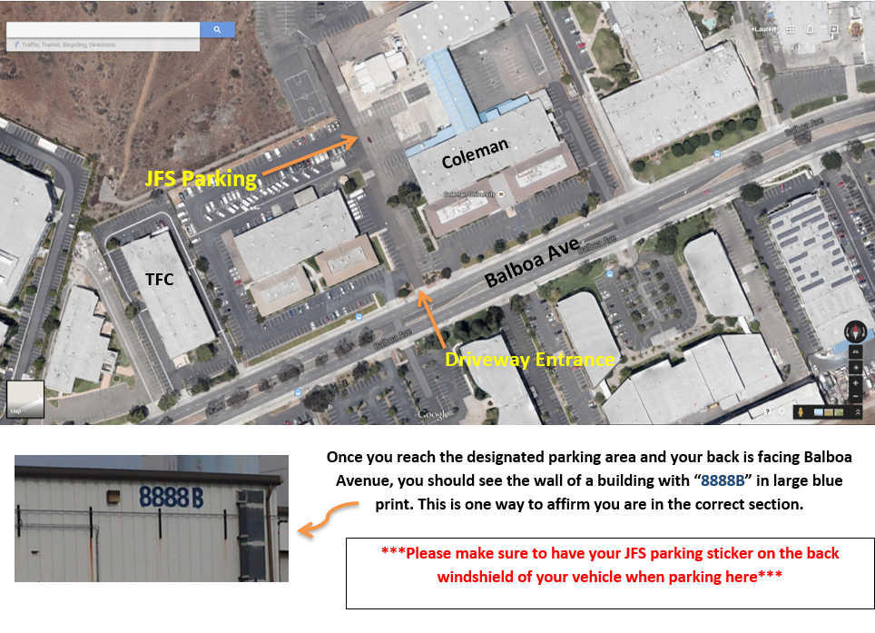
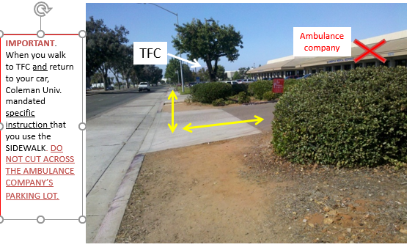
Parking- Coleman
Notes:
This is our parking lot that many of our paid staff use. There are specific spots labeled JFS. If you are working at the Balboa Ave campus you can park at Coleman. But if you are unable to park here we are happy to accommodate.

Slide 14
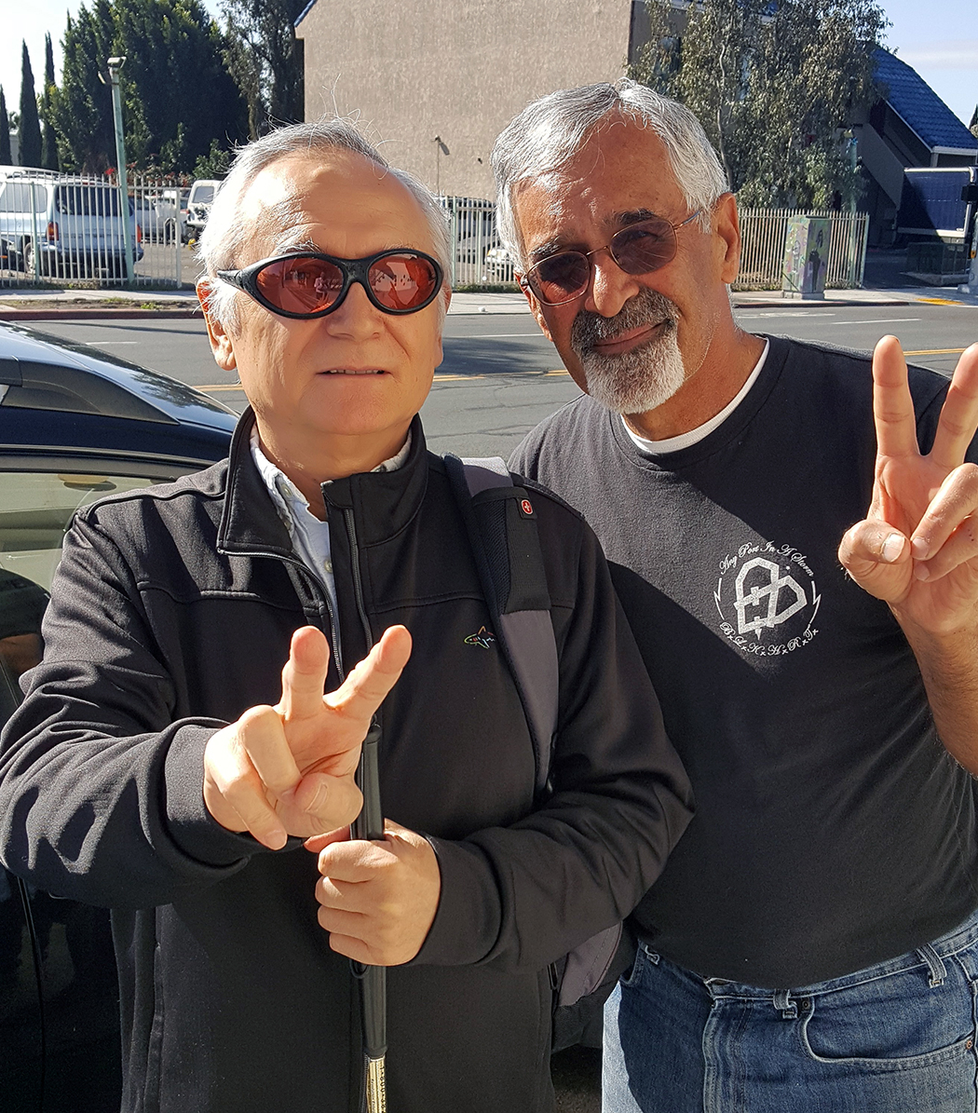
Next Steps
Participate in an in-person interview
Complete background check & DMV pull, if applicable
Get placed!
Attend training, if applicable

Slide 15

Let’s Stay Connected
Be the first to hear inspiring stories, community news,
and exciting opportunities to get involved with JFS.
Join the conversation on Facebook, Instagram, and LinkedIn!
Notes:
Notes:
We conducted a survey to ask our volunteers what we could be doing better and they told us that they wanted more ways to connect so we started our donuts and discussion.

Slide 16
Questions?
Contact Volunteer Engagement
(858) 637-3050
volunteer@jfssd.org

