Slide 1

Achieving Diversity as a Jewish Agency Board: Part I
Susan Friedman
Board Dynamics Consulting

Slide 2
Why Board Diversity ?
Research Finding:
Systems perform best when internal diversity reflects the diversity of the environment
A nonprofit with a homogenous board can suffer from debilitating tactical myopia
Demographic diversity serves as a symbol of the organization’s values
CAVEAT: Diversity looks different for every organization – ONE SIZE DOES NOT FIT ALL!

Slide 3
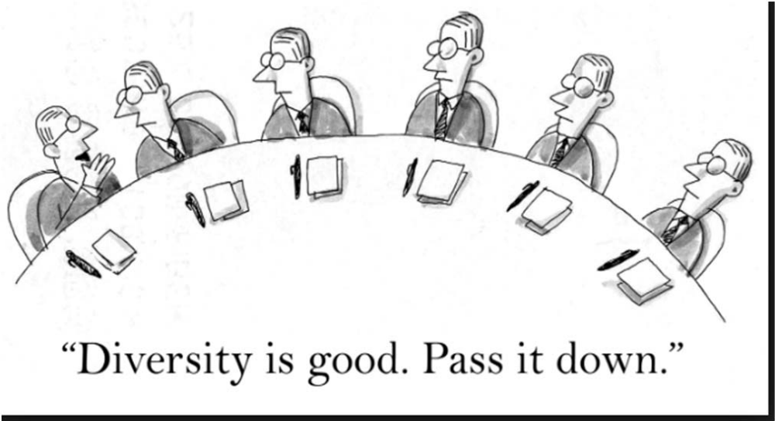
What is wrong with this picture?

Slide 4
What comprises Diversity?
Men, Women and/or Other with differing …
cultural and ethnic backgrounds
ages
leadership styles
financial situations
sexual orientation
language
disability
skills and professional backgrounds
geographic base
political viewpoints AND
Religion

Slide 5
How does Board Diversity add value?
  Brings multiple perspectives to the table
  Translates the needs and aspirations of community
  Opens doors to community stakeholders
  Models inclusion to the agency’s management and staff
  Encourages collaboration and partnerships
  Increases organizations “fundability”

Slide 6
A VIEW FROM THE FIELD
“United Way to make more diversity on nonprofit boards part of funding process”
The Columbus Dispatch (July 13, 2019)
“When it comes to racial and ethnic diversity, Boards of nonprofit organizations often don’t look like the communities they serve. So, the United Way of Central Ohio wants to nudge them a little closer to the local demographic. Starting early in 2020, the United Way plans to include “board diversity” as part of the criteria in its next grant-application process. Charities seeking funding from the United Way will need to have diverse boards or a board-approved plan for achieving diversity.”

Slide 7
A VIEW FROM THE FIELD
NY Times (August 2018)
  “In August, New York City’s Mayor Bill de Blasio announced as part of his cultural plan the decision to tie funding for museums and art groups to the diversity among their employees and board members. ‘Diversity’ has become one of the biggest buzzwords of the industry.”

Slide 8

Progress towards Diversity:
THE DATA

Slide 9
Board Diversity by the Numbers
Leading with Intent (Board Source Study of 1,700 Board Chairs and Agency CEO’s) highlights a serious imbalance with regard to race and age:
84% of nonprofit board members reported as white and
83 % are over the age of 40
Boards have looked largely the same for two decades
Agency CEO’s are more likely to want to diversification of their Boards than their Board chairs. (65%-41%)
No comparable data for Boards of Jewish Agencies: A Role for NJHSA ?

Slide 10
Board Diversity by the Numbers
Research Finding:
Avoiding “tokenism” requires 30% of a Board’s membership to represent other cohorts than the majority of members.
Missing: Data on Boards of Jewish Agencies

Slide 11
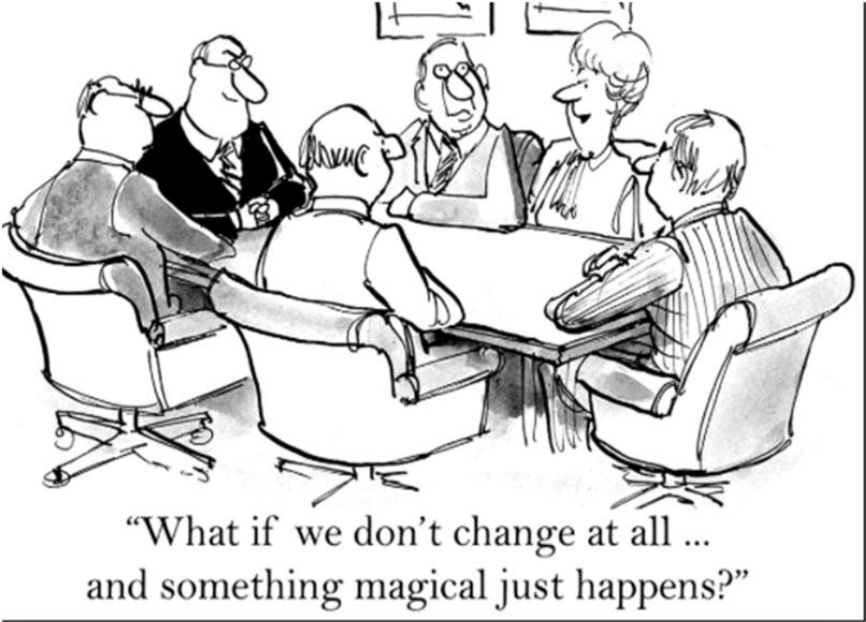
To Make Positive Change -
Ask the Right Questions

Slide 12
Ask Your Board to Consider…
Is your organization’s reputation negatively (or positively) impacted by your Board’s current composition?
If someone were to make assumptions about your organizational values based upon your board composition what would they be likely to think?
How well are you bringing your clients’/communities perspectives, needs, feedback and priorities into your strategic boardroom discussions?
Do you ever feel you are making decisions without fully understanding how they may affect those you serve?

Slide 13
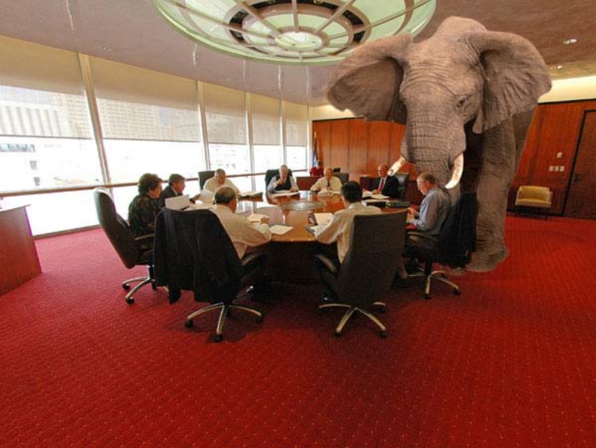
The Elephant in our Boardrooms
How do Jewish Agency Boards diversify while retaining their Jewish identity?

Slide 14
Jewish Human Service Agencies and Diversity :
The Current Environment
Most Jewish Agencies are no longer serving exclusively Jewish clientele
  (Requirement of public and some private funding)
The demands of cultural competency and positive community relations necessitates a diverse staff
Anecdotal Finding (True or False): The majority of Jewish agency Board’s have a majority of Jewish Board members

Slide 15
What Defines a Jewish Agency as “Jewish”?
One Size Does Not Fit All
Is it that…
Primary funding comes from Jewish Federations, funders, donors?
Jewish census (client and staff) is substantial in size and scope?
Agency’s mission, vision and policies are defined in terms of Jewish values?
Programs and services are in part or wholly designed for the Jewish community?
Agency is branded as a Jewish Human Service Agency ? AND/OR
Agency Leadership is Jewish?
  Board
  CEO

Slide 16
Is a Fully Jewish Board an Agency’s Last Bastion of “JEWISH”?
Explicit and implicit pressure from some Federations, Jewish foundations, communities and donors. YET…
“The times they are a changing”
(With apologies to Dylan) or are they??

Slide 17
Key Questions
How can Jewish boards effectively diversify while retaining their Jewish identity?
Is there the danger of a tipping point? A point of no return?
Lack of data in the professional Jewish communal world to provide guidance
NJHSA is looking to you its agencies to fill the breach?

Slide 18

#1
What Makes a Jewish Agency’s Board, Jewish?
“If you don’t know where you are going, any road will get you there.”

Slide 19
Diversity Begins with a Jewish Agency’s Jewish Mission & Vision
#1 MISSION AND VISION
How does the Board define, articulate and implement the mission and vision of the organization.
Starts with the agency’s mission and vision statement. Do they…
  Include a statement about having an impact on members of the Jewish community
  Reflect the” Jewishness” of the organization
  OTHERS??

Slide 20
For that matter,
What is “Jewishness”?
  Jewishness is not homogeneous concept
    3 Jews and 4 shuls.
  Between Judaism’s different branches Jewishness itself does not have one definition

Slide 21
???
For instance, what is the difference between:
  A Jewish conversation and a conversation among Jews?
  Jewish music, art or writing and the music, art or writing of Jews?
  Jewish ideas, positions thoughts and ideas or the same held by Jews
  Jewish community or a group of Jews

Slide 22
#2
Agency Policies & Practices
How does your Board integrate Jewish values and traditions into the policies and practices of your agency?

Slide 23
Agency Policies & Practices, cont’d.
For example:
  Does your agency open its doors on Shabbat?
  Serve kosher food at events?
  Celebrate Memorial Day and Israeli Independence Day?
  Others??

Slide 24
Agency Policies & Practices, cont’d.
  Does the Board evaluate its CEO, on the extent to which the agency …
  incorporates Jewish programming into the offerings of the agency,
  promotes collaboration with other Jewish community agencies, synagogues and day schools,
  ensures that education and dialogue on the Jewish mission of the agency is part of staff training etc.
  Incorporates Jewish values into HR policies and management behavior
  OTHERS??

Slide 25
#3
Board Meetings, Culture & Education
How does your Board incorporate “Jewishness” into the agenda of the Board’s Meetings and into Board education?
Does the Agency and Board calendar and meetings avoid conflicts with important dates on the Jewish calendar?
Do you build in a D’Var Torah into every meeting (Board and meetings of full staff)?
Do you provide the Board opportunities to study Jewish texts on ethics, as well as, guidelines for avoiding conflicts of interest?
OTHERS??

Slide 26

WHAT’S NEXT??
  GETTING STARTED
  MOVING FORWARD

Slide 27
Join Us at the 2020 NJHSA Annual Conference for:
How to Develop and Present a Formal Case for Board Diversification
How to Expand Your Board Search to Incorporate Diversity
How to Effectively Onboard in Support of Diversity and Inclusion
AND MORE…

Slide 28

SEE YOU THEN !
QUESTIONS ??
Susan Friedman
Boardynamics@gmail.com
201-400-6929

